Slide 1
Asymmetric Space Weathering and Impact Gardening on Lunar Crater Walls
Kilho Baek¹, Sungsoo S. Kim¹, and Chae Kyung Sim^{2,3}
¹Kyung Hee University, Korea
²Korea Astronomy and Space Science Institute (KASI)
³Korea National University of Science and Technology (UST)

Slide 2
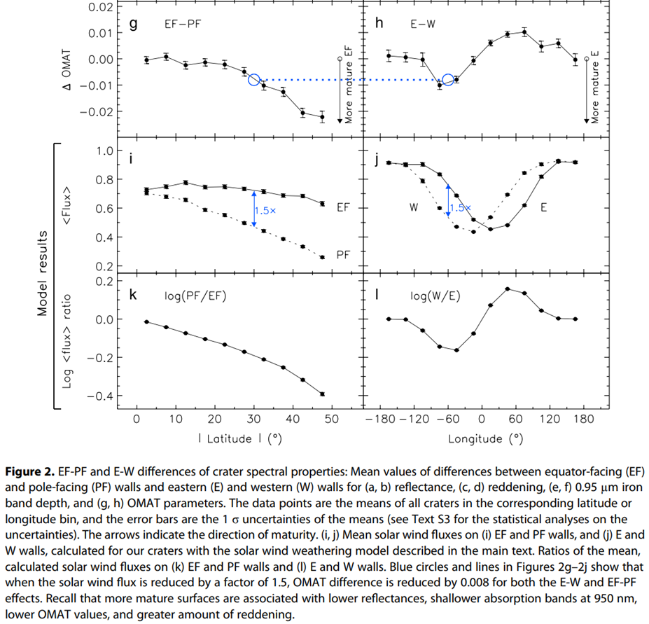
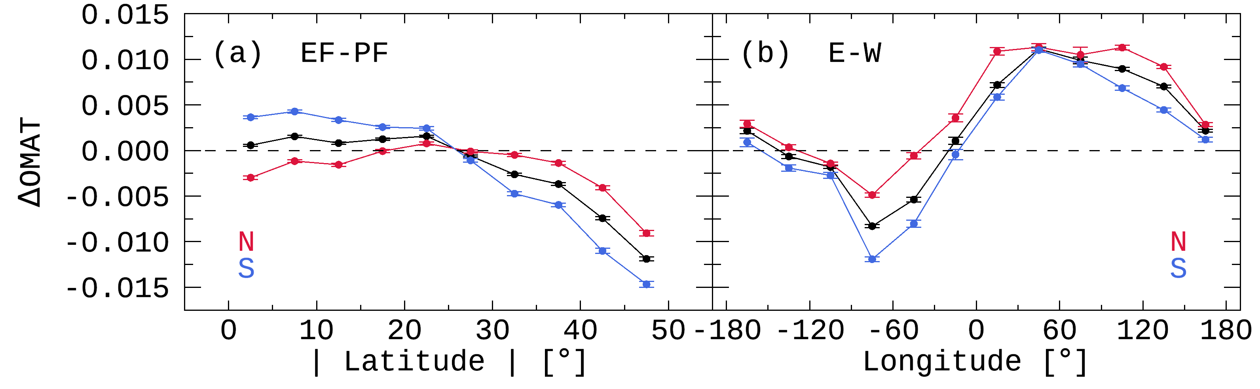
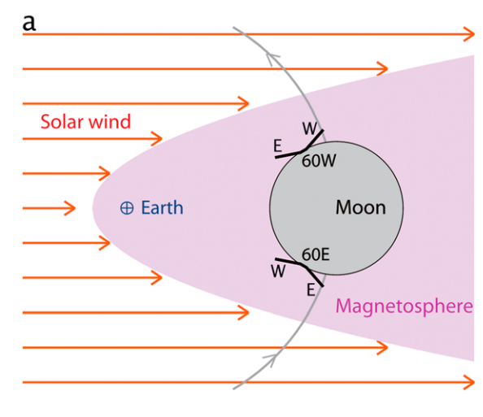
Overview
Sim et al. (2017) GeoRL
This Study
The latitudinal and longitudinal trends
analyzed by dividing into the N and S hemispheres
Hemispheric asymmetry
Longitudinal offset
Stronger
Flux
N
EF wall
solar wind
PF wall
Space weathering
(solar wind particles)
Impart gardening
(meteoroids)
Same Flux
Lat.
Equator

Slide 3
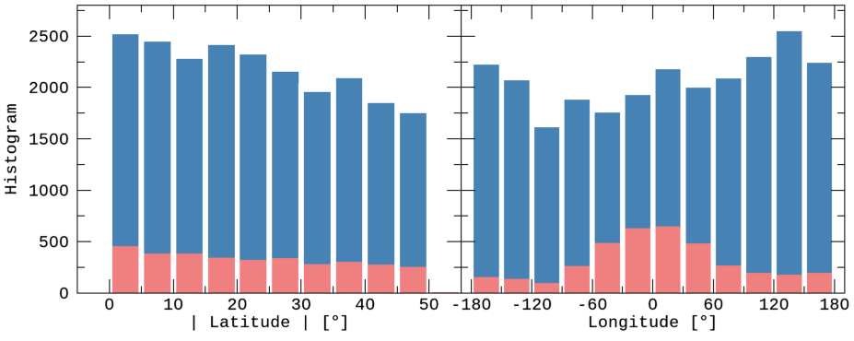
Data
Lunar Impact Crater Database
Global Map
 | LPI (2015) | Robbins et al. (2018)
Total Number | 8716 | ~1.3 million
Main Information | Latitude & Longitude
 | Diameter | Major/Minor-axis
 | Topography | Photometry
Data | DEM (Digital Elevation Map) | Reflectance (415 ~ 1550 nm)
Instrument | LRO LOLA + Kaguya TC | Kaguya MI
Latitude | -60° ~ +60°
Resolution | 512 ppd (≈ 60 m/pixel)
(for the comparative verification)
(for detailed analysis)
Extended Crater Sample
2018 DB
2015 DB
 | Sim et al. (2017) | This study
Database | LPI 2015 |  | Robbins et al. (2018)
Samples | 1,872 | 3,144 | 26,802
Resolution | ~1 km/pixel | ~60 m/pixel
Diameter | 5 ~ 120 km |  | 2 ~ 120 km

Slide 4
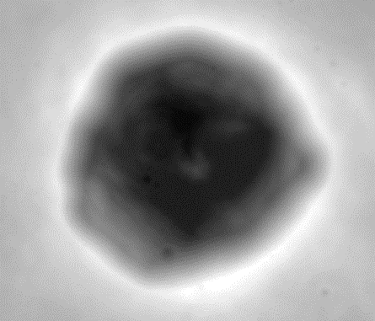
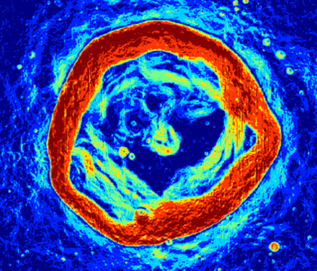
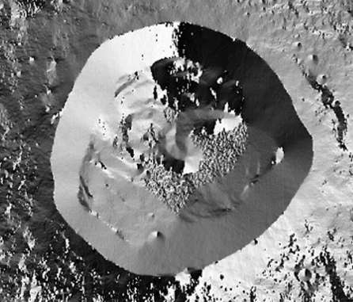
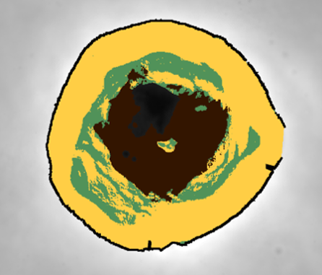
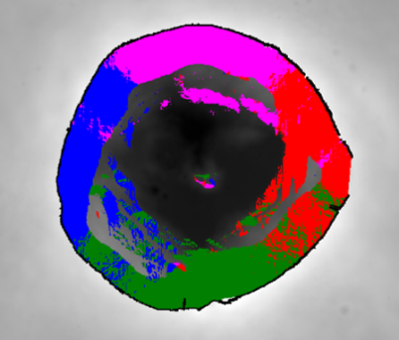
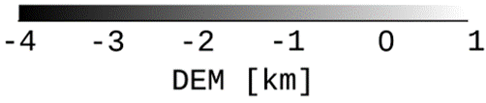
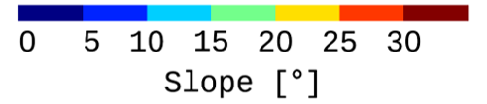
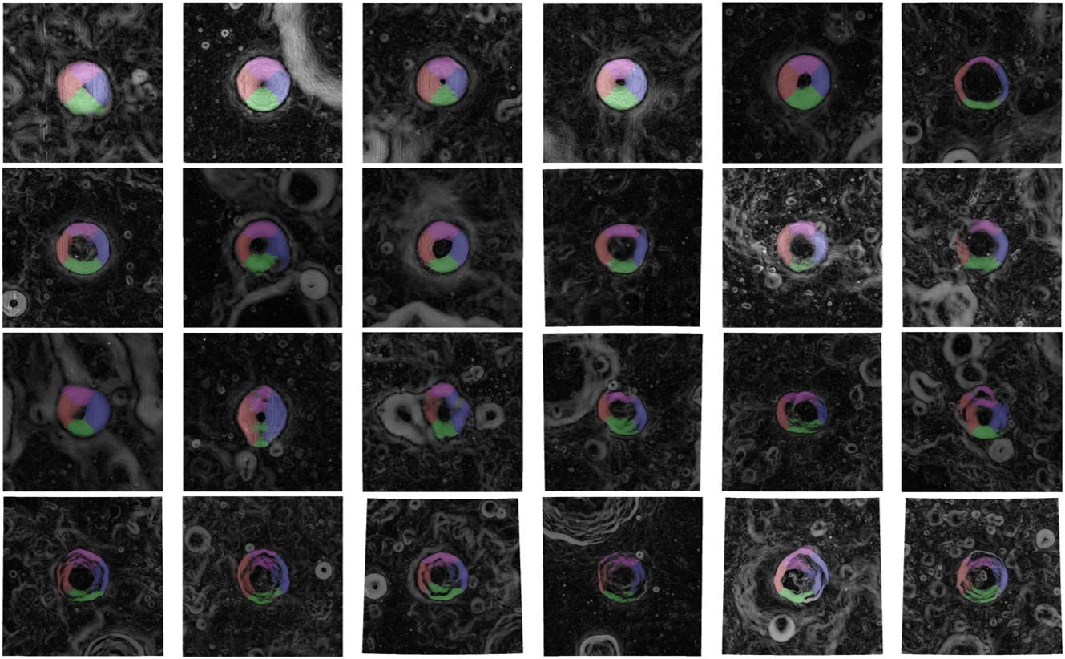
Methods: Data Processing
DEM [km]
Slope [°]
Azimuth Angle [°]
Inner Structures
Wall-Quadrants
rim
3D vector
calculation
DEM
Slope
Azimuth
-4
-2
0
0
10
20
30
-180
0
180
Floor
Terrace
Wall
W
N
S
E
Simple
Complex

Slide 5
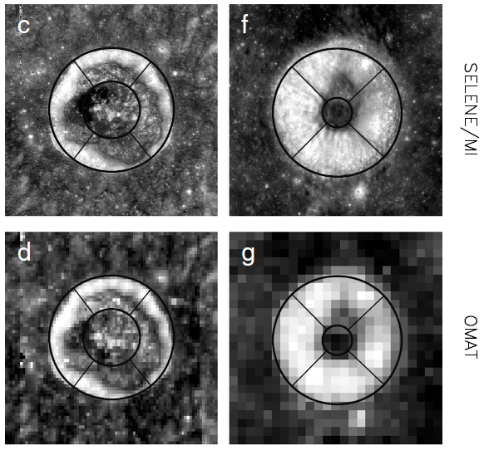
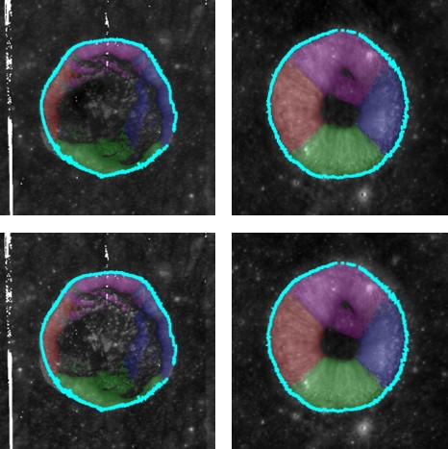
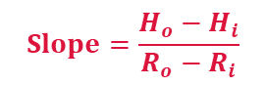
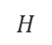
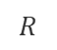
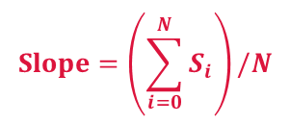
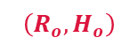
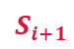
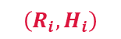
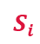
Methods: Improvements
Sim et al. (2017)
This study
① Spatial Resolution of OMAT
① - 1 km/pixel ➔ 60 m/pixel
① - Min. diameter: 5 km ➔ 2 km
② Defining Crater’s Rim
② - More precise and accurate rim
③ Classifying Inner Structure
③ - Floor, terrace, wall (> 15°)
③ - More precise and accurate wall
④ Well-Preserved Crater
④ - Crater’s rim must cover azimuth ④ - of at least 330°
④ - More than 250 pixels on each wall
Slope between two points
Average of all pixels on the walls
$$H$$
$$\left(R_{o}, H_{o}\right)$$
$$Slope=\left(\sum_{i=0}^{N}{S_{i}}\right)/N$$
$$Slope=\frac{H_{o}−H_{i}}{R_{o}−R_{i}}$$
$$S_{i+1}$$
$$\left(R_{i}, H_{i}\right)$$
$$S_{i}$$
$$R$$

Slide 6
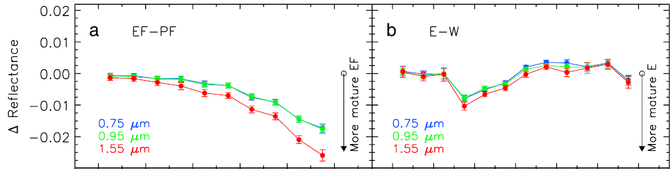
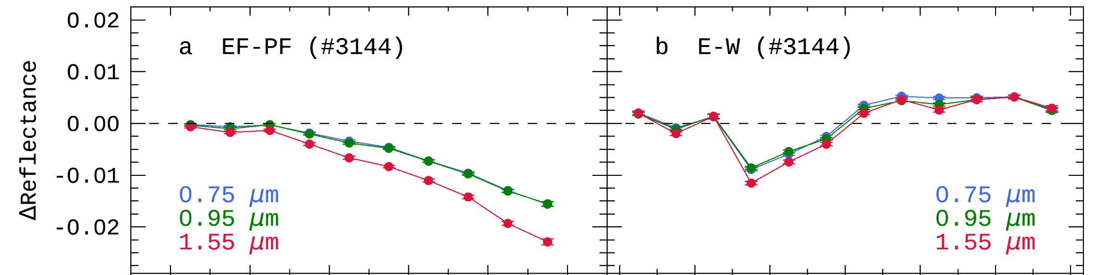
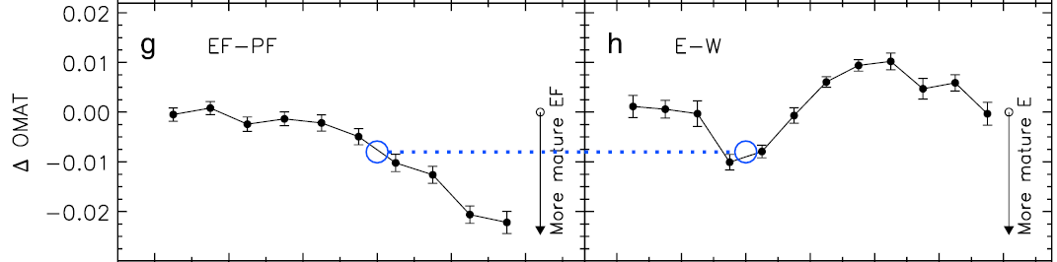
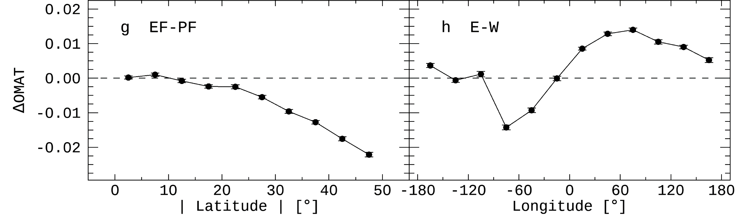
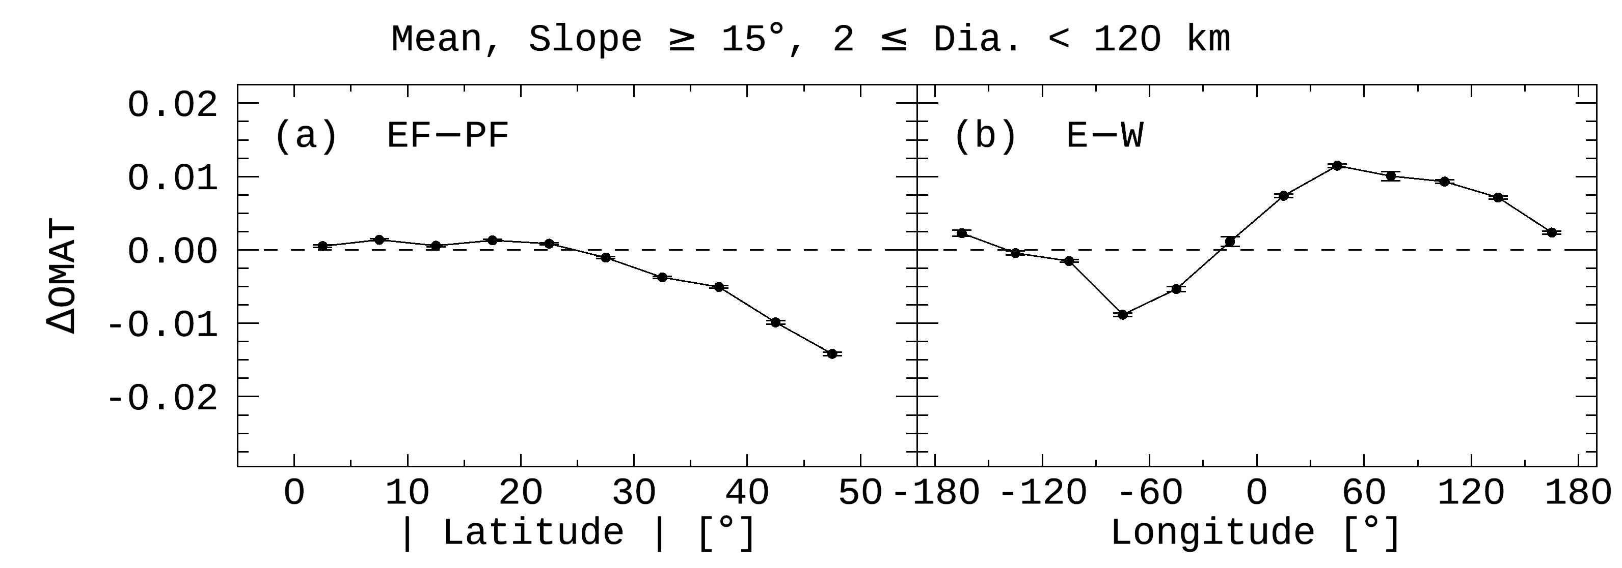
Results: Algorithm Verification
Reproducing the Previous Study [Sim et al. (2017) GeoRL]
Sim et al. (2017): 2015 DB > 1,872 craters
This study : 2015 DB + improved algorithm > 3,144 craters
This study : 2018 DB + improved algorithm > 26,802 craters

Slide 7
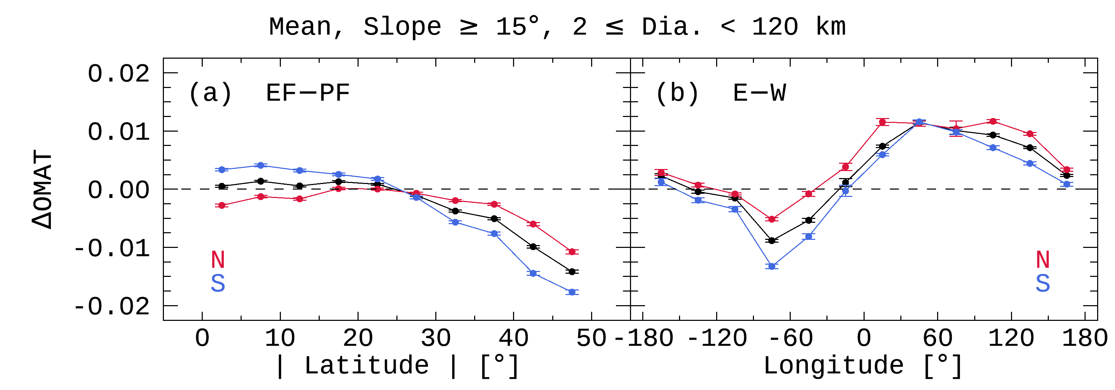
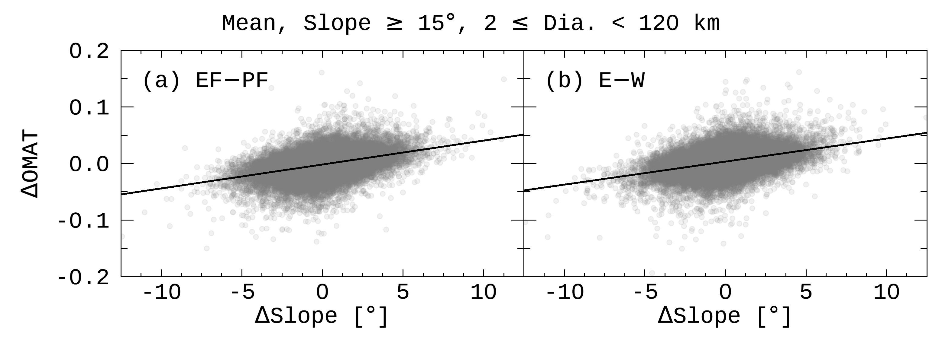
Results: Northern & Southern Hemispheres
① Hemispheric Asymmetry
➔ [Something] makes ➔- S wall fresh near the equator.
① Hemispheric Asymmetry
➔ [Something] makes ➔? S wall fresh near the equator. ➔? N wall mature near the equator.
①
②
①
② Longitudinal Offset
➔ [Something] makes ➔- E wall fresh at any longitude.
② Longitudinal Offset
➔ [Something] makes ➔? E wall fresh at any longitude. ➔? W wall mature at any longitude.
?
[Something] = Meteoroids
crater wall
surface
impact
terrace
➔ A wall with a steeper slope is fresher than the opposite wall.
average Slope
average OMAT

Slide 8
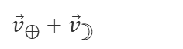
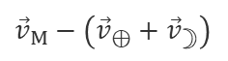
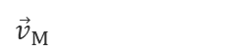
Meteoroid Environment near the Moon
Meteoroids make
① S wall fresher than N wall near the equator.
② E wall fresher than W wall at any longitude.
Anti-Helion Source
Flux: E wall < W wall
Helion Source
Flux: E wall > W wall
${\vec{v}}_{⊕}+{\vec{v}}_{☽}$
${\vec{v}}_{⊕}+{\vec{v}}_{☽}$
${\vec{v}}_{M}$
${\vec{v}}_{M}$
${\vec{v}}_{M}−\left({\vec{v}}_{⊕}+{\vec{v}}_{☽}\right)$
${\vec{v}}_{M}−\left({\vec{v}}_{⊕}+{\vec{v}}_{☽}\right)$
29.80
48.15
47.11
29.80
E
W
N-Pole
29.07
47.38
46.63
29.07
30.51
48.61
47.89
30.51
W
E
E
W
E
W
W
E
W
E
N wall
28.76
46.74
46.74
28.76
29.78
km/s
29.78
km/s
30.80
48.51
48.51
30.80
Moon
Lat.
26.65
E
W
⊕
Earth
E
W
26.65
Equator
Moon
Moon
⊕
Earth
Moon
Moon
Helion
Anti-Helion
W
E
W
E
S wall
29.07
46.63
47.38
29.07
30.51
48.89
48.61
30.51
E
W
E
W
29.80
47.11
48.15
29.80
W
E
W
E
S-Pole
E
W
W
E
1.02 km/s
1.02 km/s

Slide 9
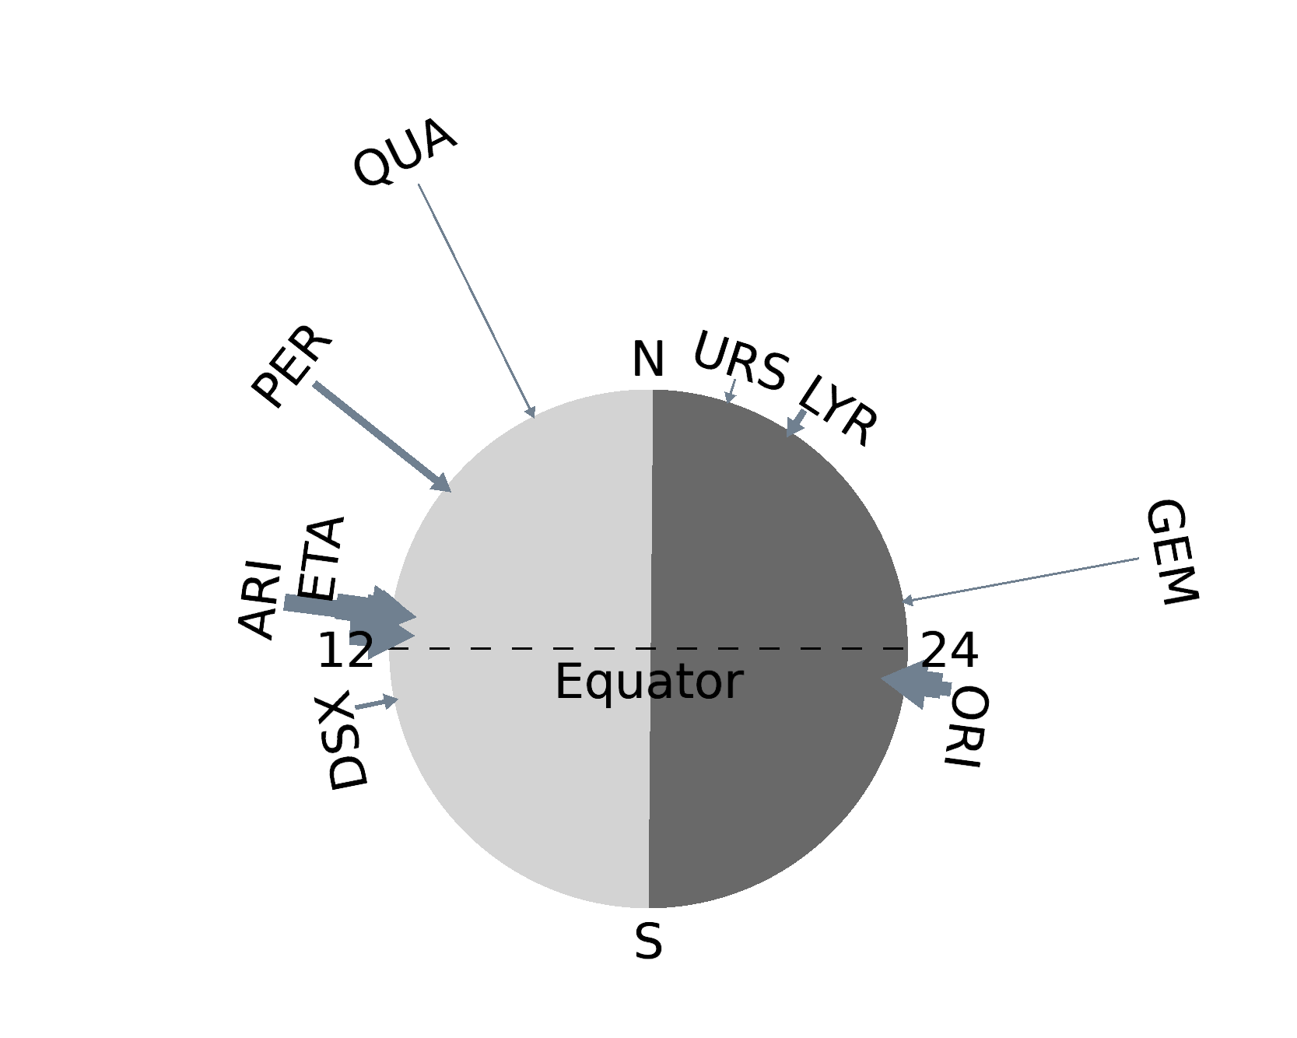
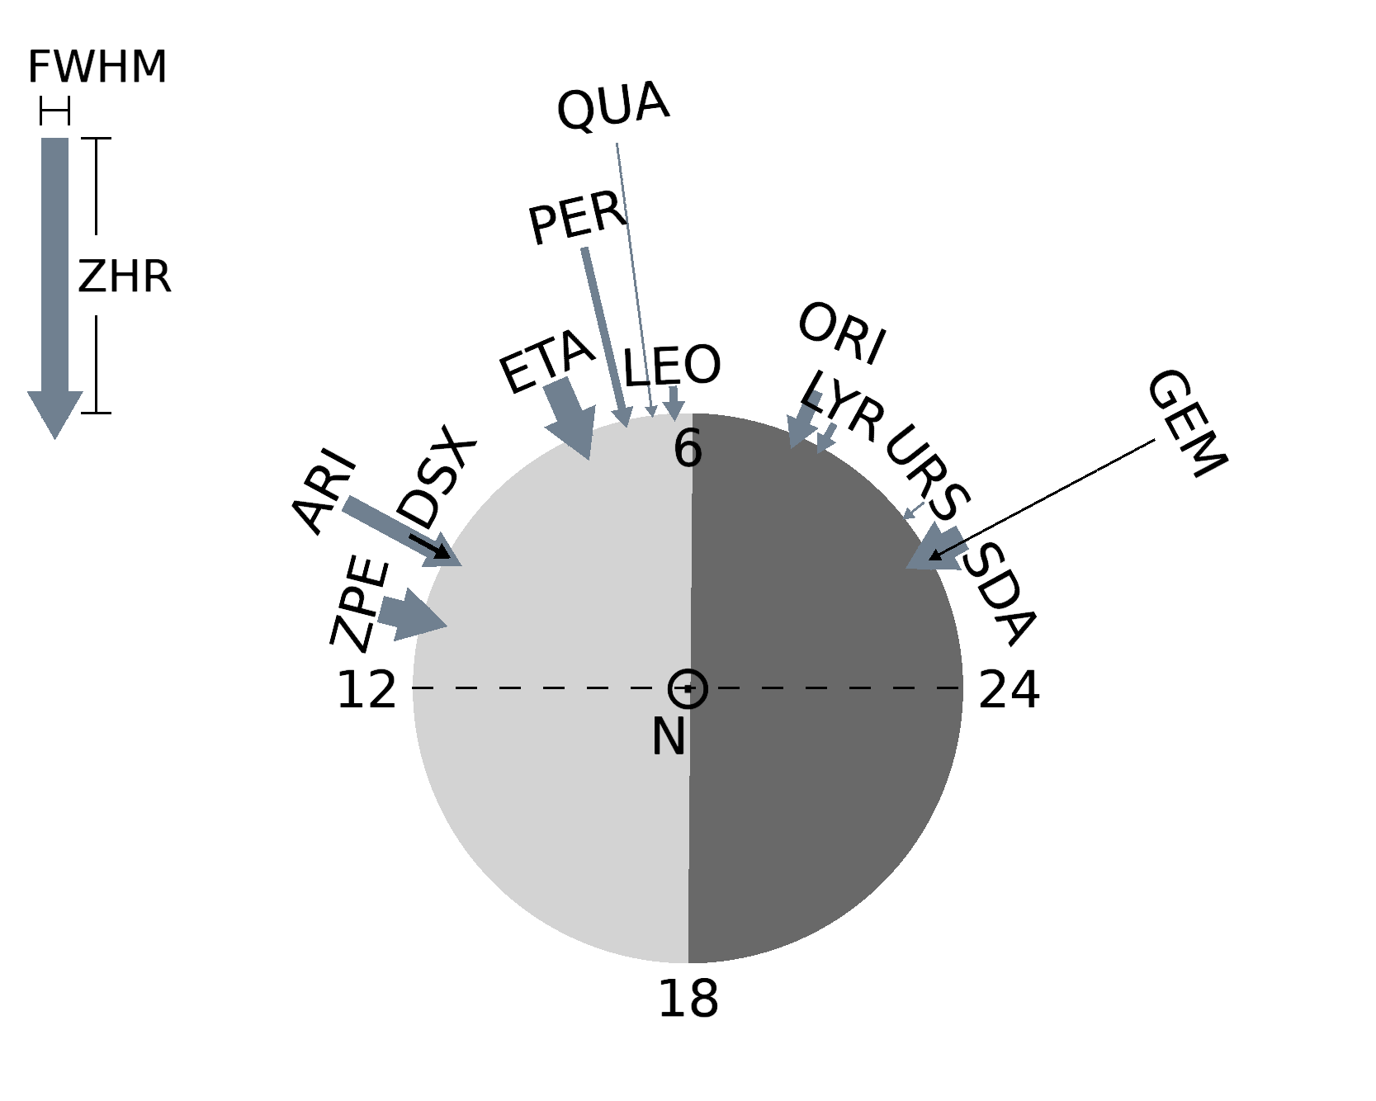
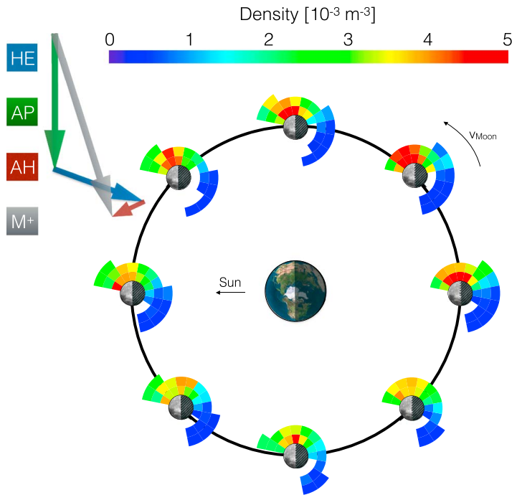
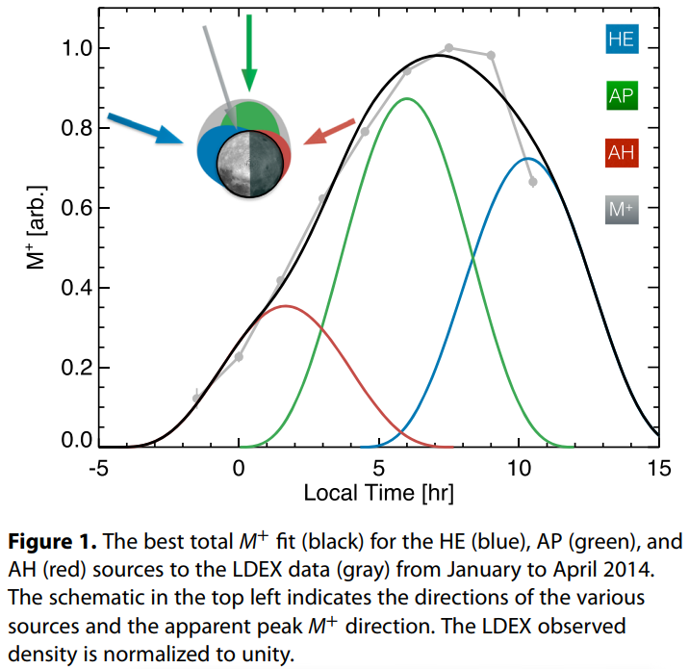
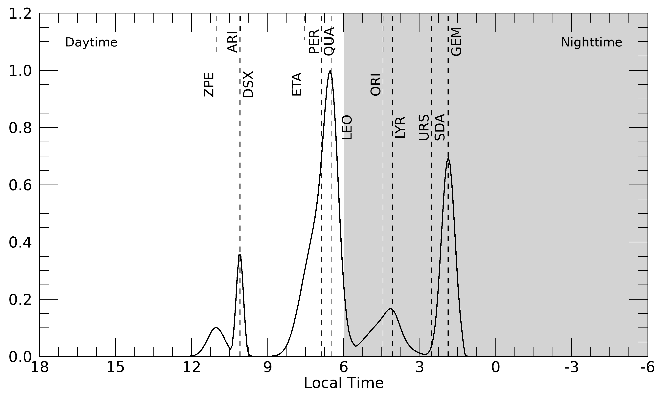
Meteoroid Environment near the Moon
Meteor Showers
Sporadic Meteoroids
Refer to the Tab. 7 of Merisio & Topputo (2023)
Szalay & Horányi (2015) GeoRL

Slide 10
Modeling: Solar-Wind + Meteoroids
Simple Model (Sim et al., 2017)
> Solar-wind particles
> - Earth’s magnetosphere
+ Orbital motion of the Earth
+ - Average speed ≈ 29.78 km/s
+ Sporadic meteoroids (Szalay & Horányi, 2015)
+ - Helion, Antihelion, Apex
+ - Ecliptic lat. the radiant ≈ 0°
+ - Flux: Helion > Anti-Helion
+ Meteor showers (simple assumption)
+ - Local time of the radiant = [12, 24]
+ - Ecliptic lat. of the radiant ≈ 30°
+ - Flux: Helion > Anti-Helion
Apex
W
E
E
W
W
E
W
E
Helion
Anti-Helion
E
W
E
W
Solar wind
29.78
km/s
W
E
⊕
Earth
W
E
Shower
Moon
Moon
Shower
E
W
E
W
Magnetosphere
W
E
W
E
E
W
E
W
W
E
E
W
1.02 km/s

Slide 11
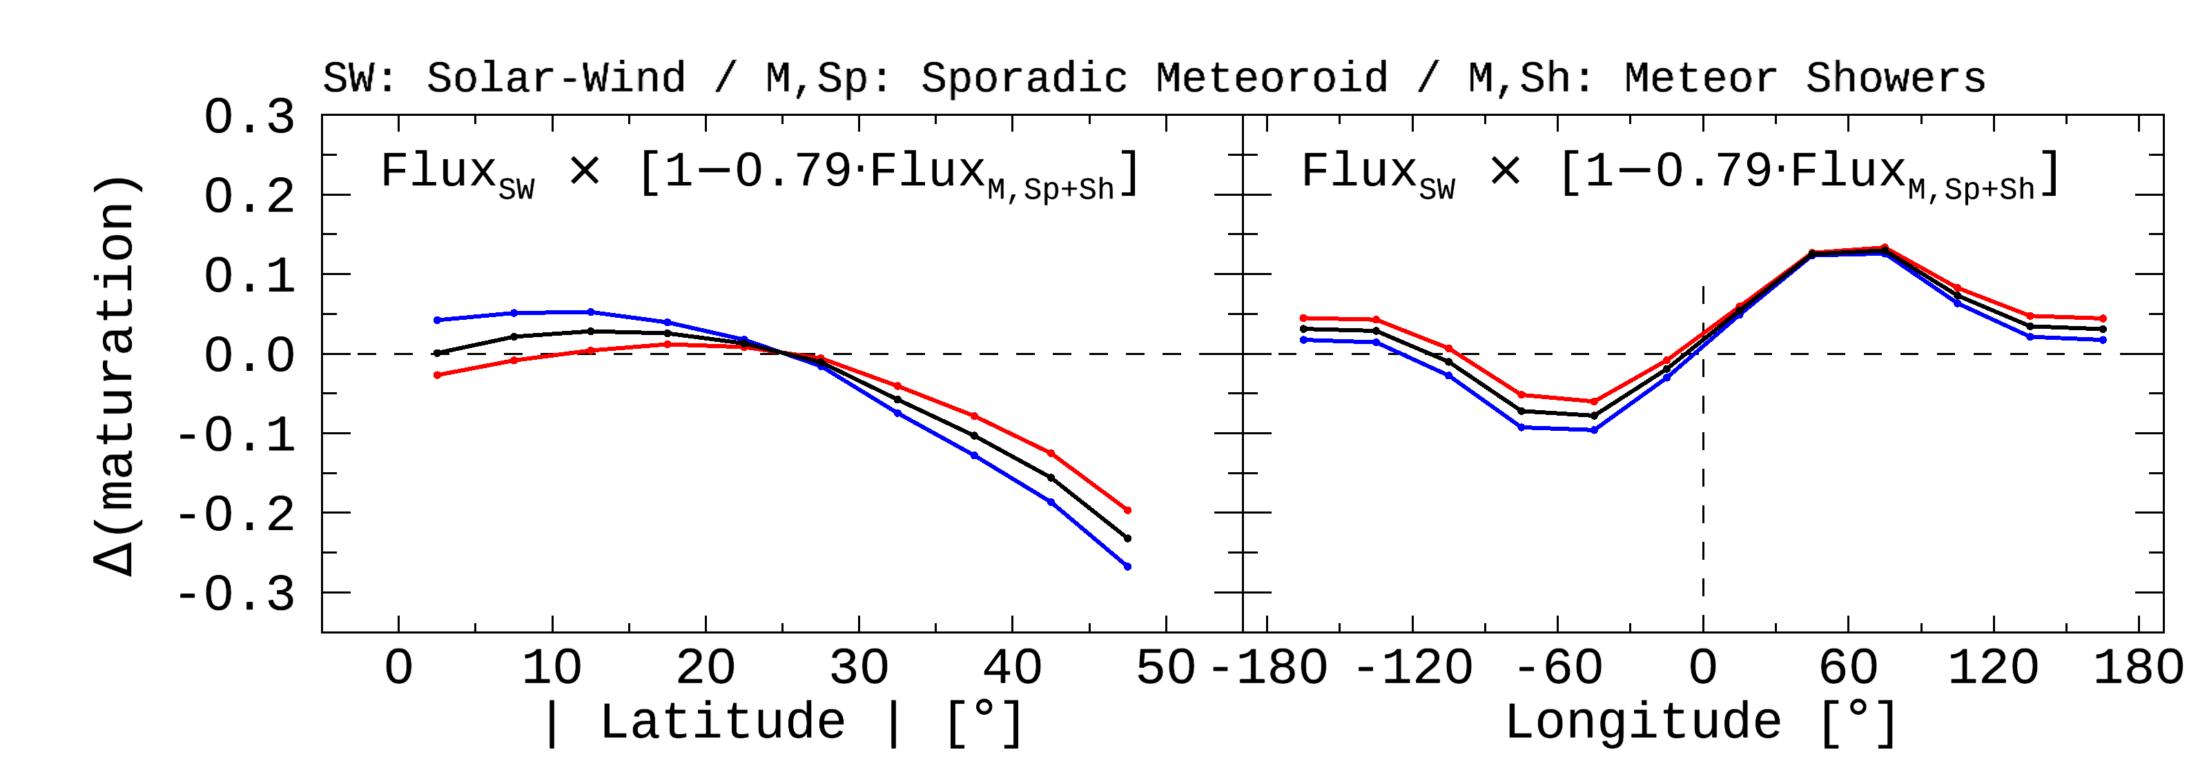
Modeling: Solar-Wind + Meteoroids
Observation
Our Model

Slide 12
Summary
Improvements (1) Data processing has been improved to define realistic features of a crater. (2) The number of craters available for analysis was extended from 1,872 to 26,802. ➔ We ensured statistical significance by reproducing the previous study.
New Findings & Modeling (1) N-S hemispheric asymmetry << Meteor showers (2) Longitudinal offset << Meteor showers & Sporadic meteoroids ➔ We are combining the effects of space weathering by solar-wind and impact gardening by meteoroids
Earth’s orbital motion
Flux: Helion > Anti-helion
Impact Gardening |  | Space Weathering
Meteoroids |  | Solar-Wind Particles | Micrometeoroids
Sporadic Meteoroids | Meteor Showers
Excavation or Gardening (fresh soils come up to the surface) |  | Sputtering (npFe) | Comminution (grain size become smaller) | Sputtering (npFe & mpFe)
refreshment |  | maturation | maturation
This study
Future Work

